Slide 1
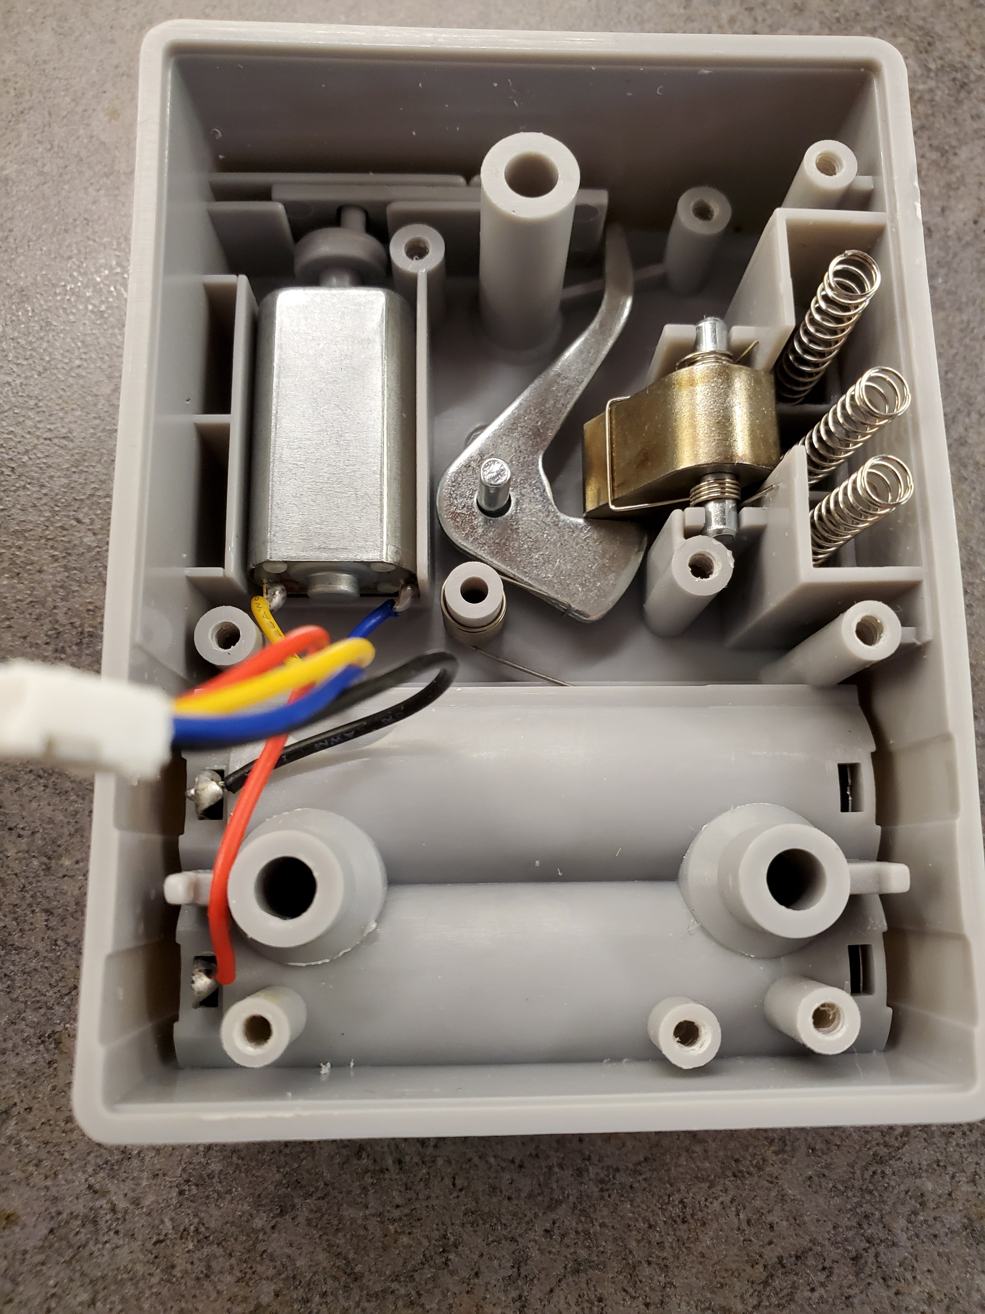
PLASTIC SLIDER
LOCKING ARM
MOTOR
LOCKING TONGUE
RETAINER SPRINGS

